Slide 1
Digital Twin of Drone using Matlab /Simulink
Group-1 :
1)Vikas Chelluru(S20200020252)
2)Viswa Teja Kalthuri(S20200020271)
3)Shaik Vazeer Ahamed(S20200020301)

Slide 2
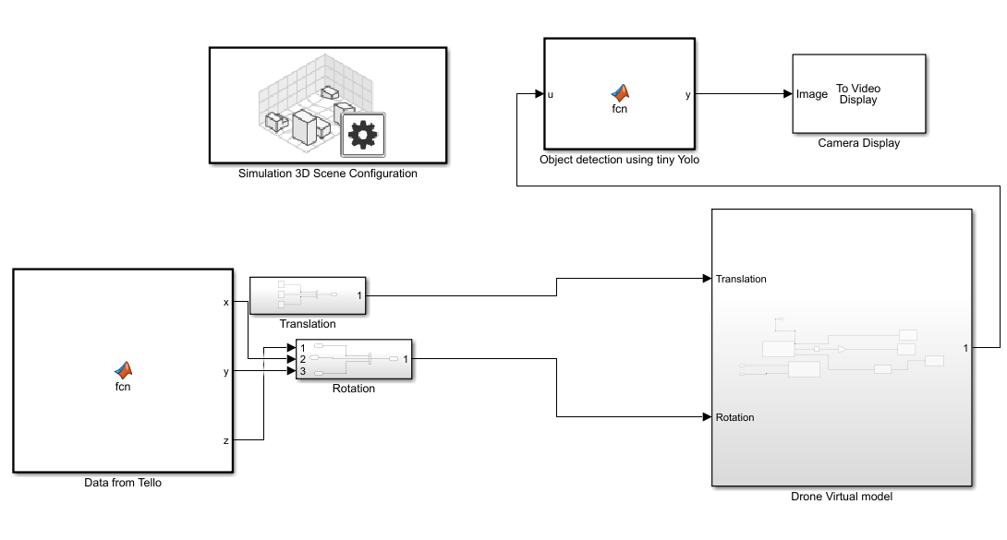
Block Diagram:-

Slide 3
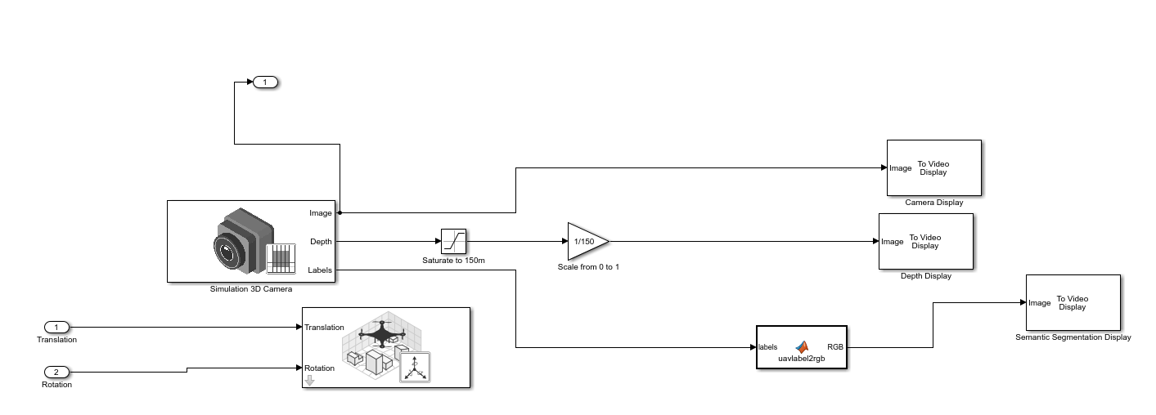
Drone Virtual Model:

Slide 4
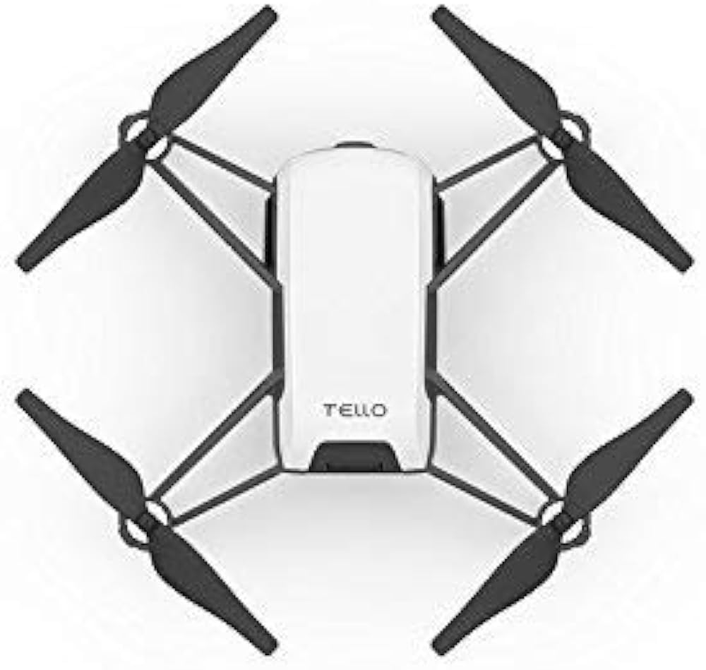
Final Evaluation:-
Establishing connection and controlling Tello drone with Matlab , Node-Red and OPCUA.
Object detection on drone video feed using tiny YoloV3 model.
Display drone orientation data on matlab and node-red.
Control the virtual drone model using orientation data.

Slide 5
Final Evaluation Results

Slide 6
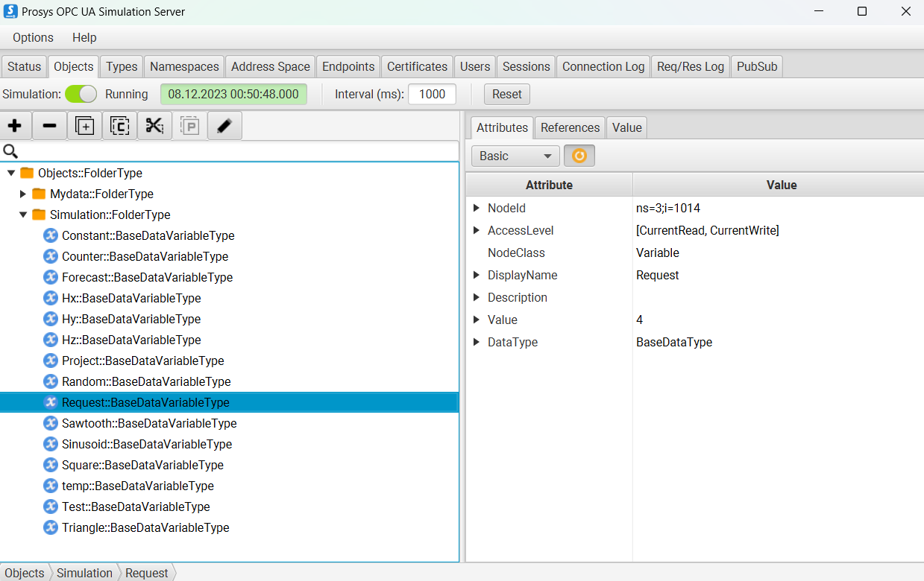
OPC-UA Server:

Slide 7
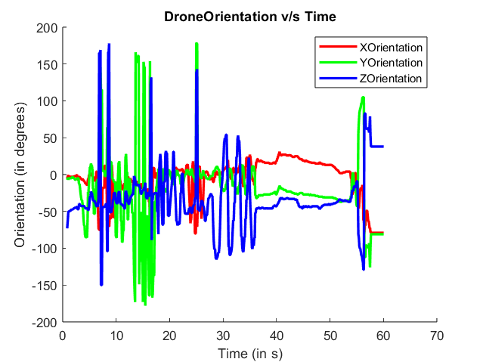
Real time orientation of Tello Drone:

Slide 8
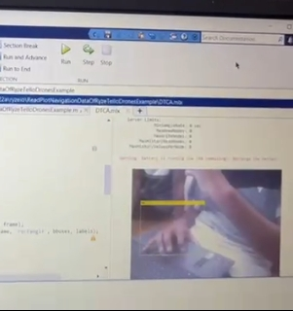
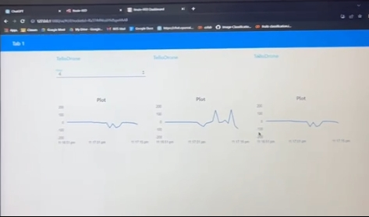
Object detection using Tiny YoloV3: Orientation data display on Node-red

Slide 9
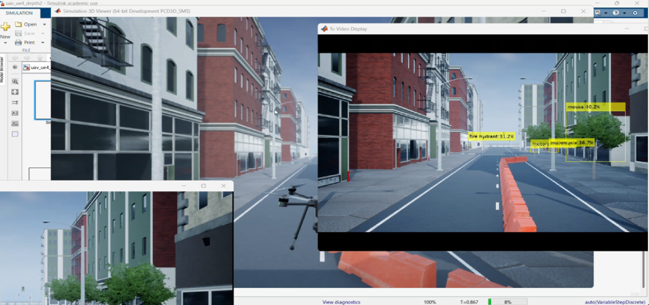
Simulation Result:

Slide 10
Challenges:-
Challenges in Connectivity
Simulink Integration Difficulties
Limited Resources for Tello Connectivity
Connectivity and scalability aspects:-
We can create complete Digital Twin of this drone.
Swarm formation

Slide 11
Thank You!

